Slide 1
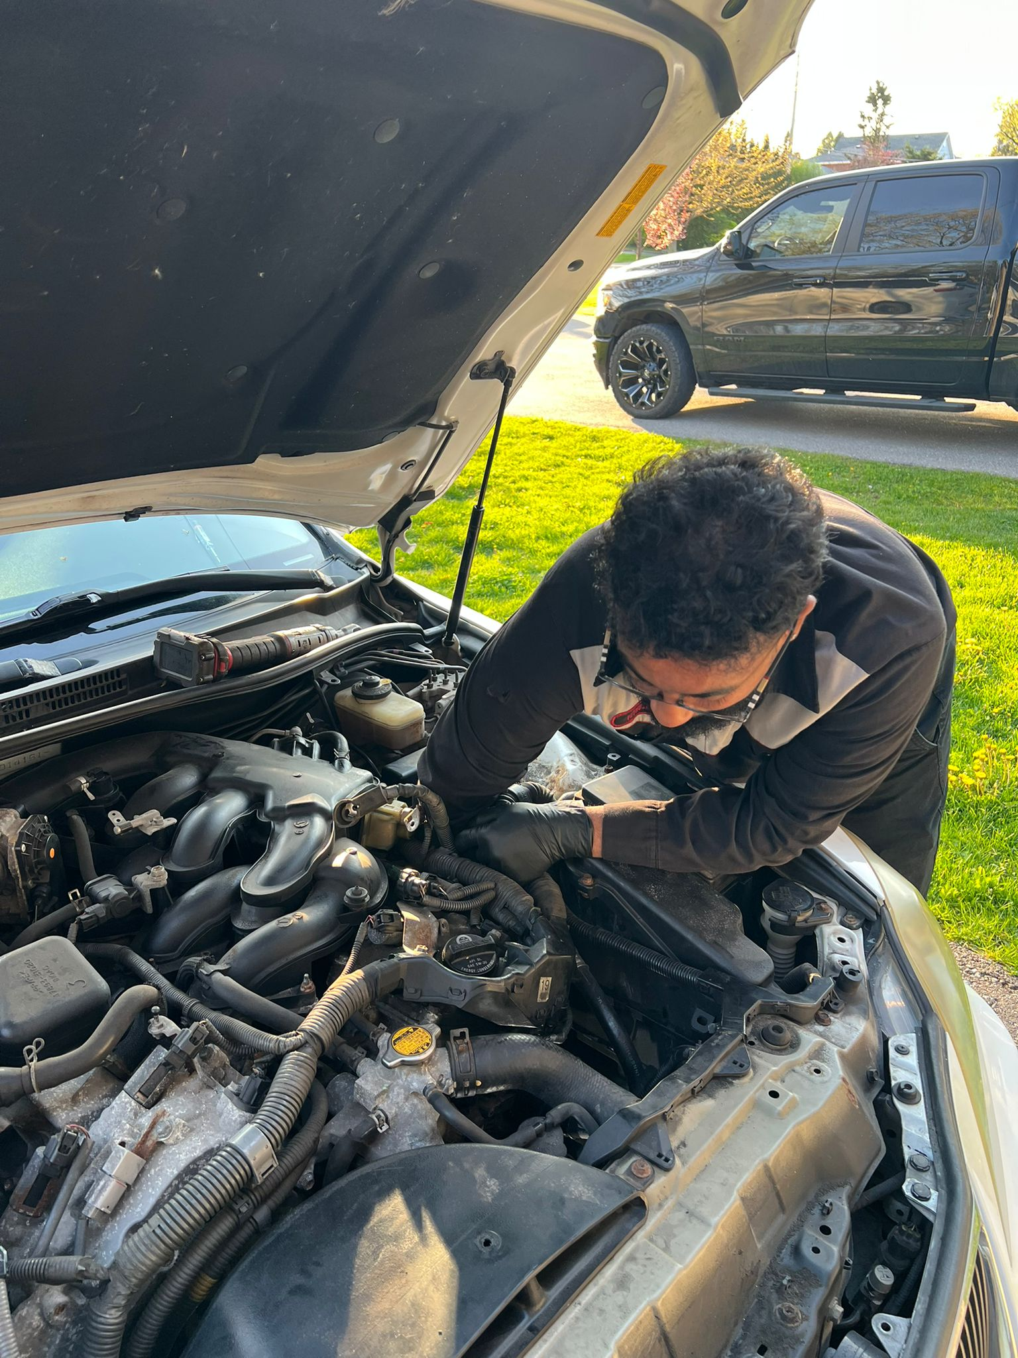

AutoVivo
Auto Repair, Reimagined.
Mobile. On-Demand. At Your Location.
3–5
4
100%
Mechanics
Ready
Core
Team
Product
Built
Your mechanic, wherever you are.
Semi Finals / Finals Pitch · 2025
AutoVivo · Pitch Deck 2025

Slide 2
PROBLEM STATEMENT
Auto repair is broken.
4.8
26%
12%
days avg
of drivers
of repairs
Wait time for an appointment
(up from 1.8 days in 2021)
Wait 2+ weeks before
getting their car fixed
Are not fixed correctly
the first time
Traditional repair forces customers to disrupt their entire day — drop off a car, arrange a ride, and wait hours or days. There is no good reason it still works this way.
AutoVivo · Confidential

Slide 3
THE SOLUTION
We bring the garage to you.
Mobile Service
M
Fully-equipped technicians come to your home, office, or wherever you are.
Instant Booking
B
Book in minutes online — confirmed immediately, no phone calls or hold music.
Certified Experts
C
Every tech is certified and vetted — from oil changes to complex diagnostics.
Real repairs. At your location.
AutoVivo · Confidential

Slide 4
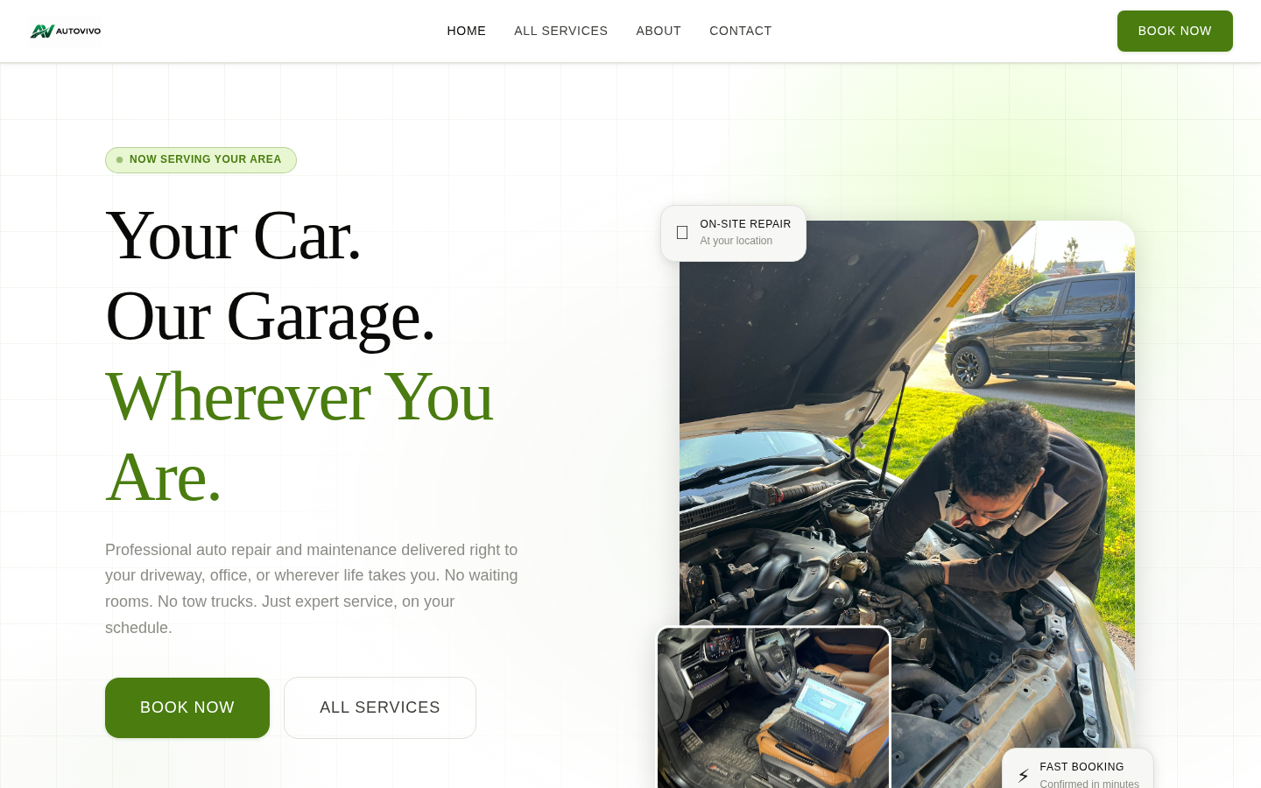
PRODUCT
A seamless end-to-end booking experience.
1
Conversion-focused landing page with a clear CTA above the fold
2
Google Reviews carousel with 11 real customer testimonials
3
Transparent pricing, process steps, and trust indicators
4
Fully responsive — optimised for mobile-first users
AutoVivo · Confidential

Slide 5
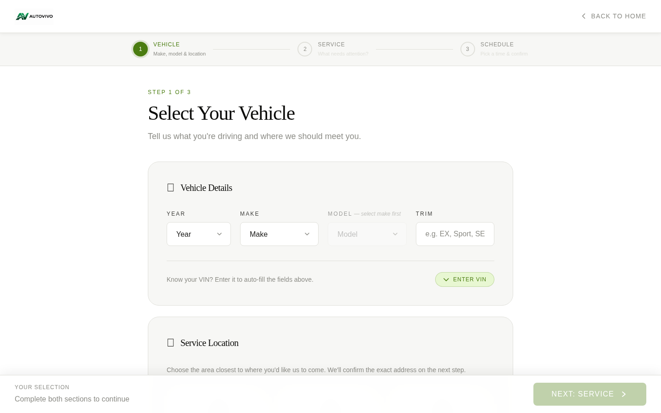
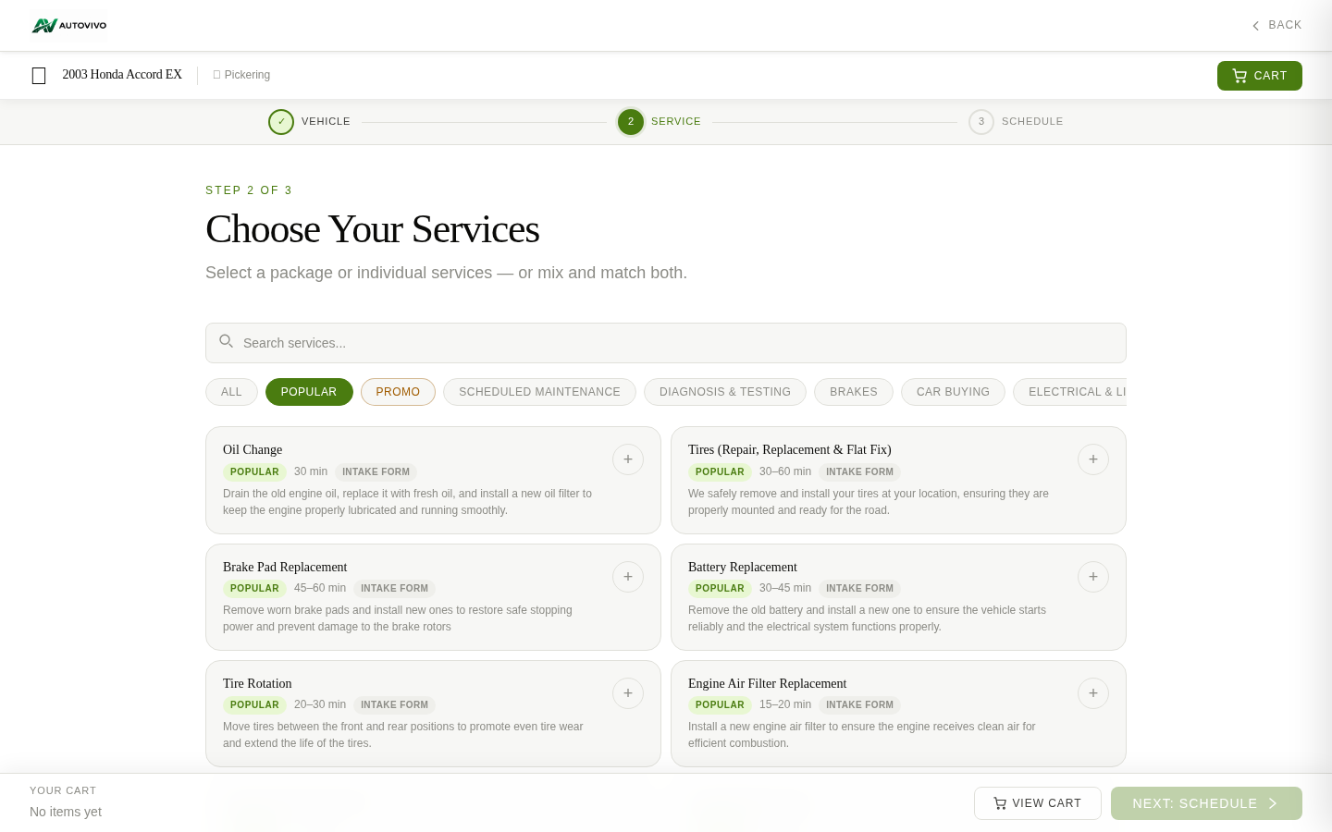
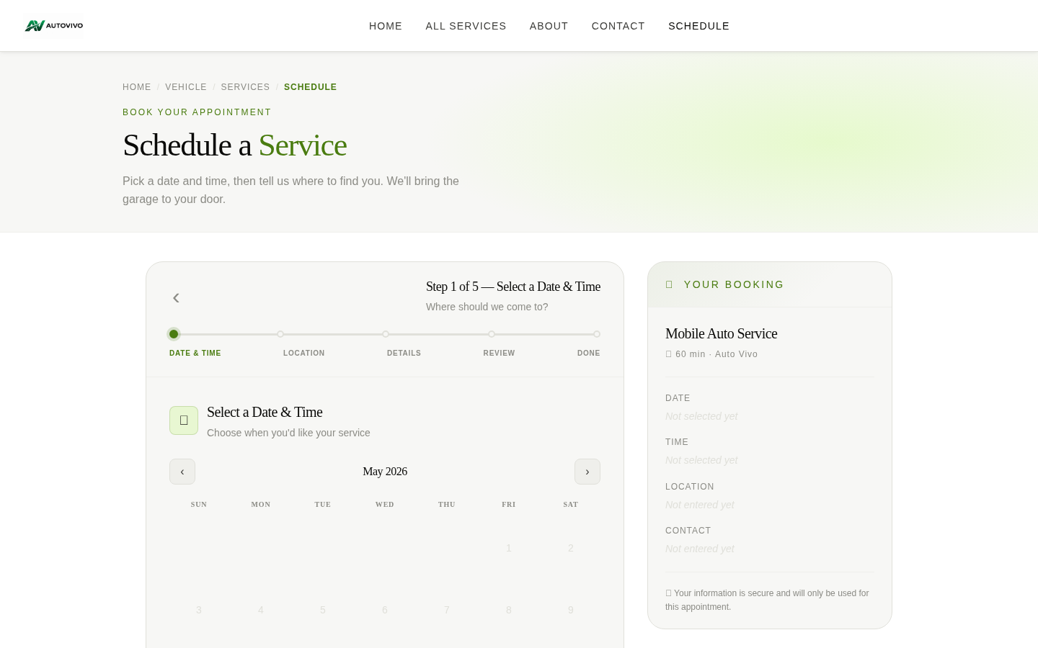
PRODUCT
3-step booking — done in under 2 minutes.
Step 1
Step 2
Step 3
Select Your Vehicle
Choose a Service
Pick a Time & Confirm
AutoVivo · Confidential

Slide 6
MARKET OPPORTUNITY & GO-TO-MARKET
A massive, underserved market ready for disruption.
Go-To-Market Strategy
TAM
1
Local Launch
SAM
Target residential & office areas in city
SOM
2
Core Segment
$880B+
$341B
$4.3B
Busy professionals 25–45, value time over price
Mobile Segment (2025)
North America
3
Digital-First
Global Auto Repair
SEO + Google Ads capture high-intent searches
Mobile repair growing at 8.82% CAGR — projected to reach $6.5B by 2030 (Mordor Intelligence)
4
Referral Engine
Loyalty credits drive repeat bookings & word-of-mouth
AutoVivo · Confidential

Slide 7
TRACTION
Pre-launch — the foundation is fully in place.
Full Product Built
Technicians Ready
1
End-to-end booking platform live — home, vehicle select, service select, and scheduling pages all complete.
2
3–5 certified mechanics recruited and ready to be onboarded at the moment we launch.
Team Assembled
Market Research Done
3
Core team of 4 in place — two developers, a UX designer, and an operations lead.
4
Consumer pain points, competitor gaps, and pricing model validated through primary and secondary research.
Launch is our next milestone. Everything is built and ready to move.
AutoVivo · Confidential

Slide 8
COMPETITIVE ADVANTAGE
Why AutoVivo wins.
Feature
Traditional Shop
Dealership
Other Mobile
AutoVivo
Comes to you
No
No
Limited
Yes
Online booking
Some
Some
Basic
Full platform
Transparent pricing
No
No
Varies
Yes
No long wait
No
No
Varies
Yes
Certified techs
Yes
Yes
Varies
Yes
Instant confirmation
No
Partial
Partial
Yes
AutoVivo · Confidential

Slide 9
BUSINESS MODEL
How AutoVivo makes money.
Per-Service Revenue
Subscription Packages
$
Customers pay per booking. AutoVivo earns a platform fee on each job.
S
Monthly plans for fleet owners and frequent customers — recurring revenue.
Premium Scheduling
Fleet & B2B Contracts
P
Same-day and priority time slots offered as a convenience upgrade.
B
Long-term service agreements with businesses, property managers, and fleet operators.
AutoVivo · Confidential

Slide 10
TEAM
The right people to build and scale this.
1
2
3
4
Leader & Ops
Developer
Developer
UX Designer
Management Lead
Full-Stack Dev
Full-Stack Dev
Product Design
Drives strategy, operations, and partnerships. The connective tissue of the team.
Builds and maintains platform architecture, booking engine, and backend systems.
Front-end experience, performance optimisation, and feature development.
Owns the end-to-end user experience — research, wireframes, and interface design.
+ 3–5 Certified Mechanics — Vetted, trained, and ready to onboard at launch.
AutoVivo · Confidential

Slide 11
ROADMAP
From launch to scale.
Phase 1 · 0–3 Mo
Phase 2 · 3–9 Mo
Phase 3 · 9–18 Mo
Phase 4 · 18–36 Mo
Launch
Grow
Expand
Scale
Go live in target market
Onboard 3–5 technicians
First 100 bookings
Gather feedback
Expand services
Referral programme
500+ bookings/mo
Local partnerships
Enter 2nd city
B2B fleet deals
Subscriptions launch
Team growth
Multi-city rollout
Franchise model
Mobile app
Series A funding
Target:
Target:
Target:
Target:
100 bookings
500 bookings/mo
2 cities live
Series A ready
Key milestones before next raise
Q1
Launch & 1st 100 bookings
Q2
500 monthly bookings
Q3-4
2nd city + B2B pilots
Y2
Scale & Series A
AutoVivo · Confidential

Slide 12
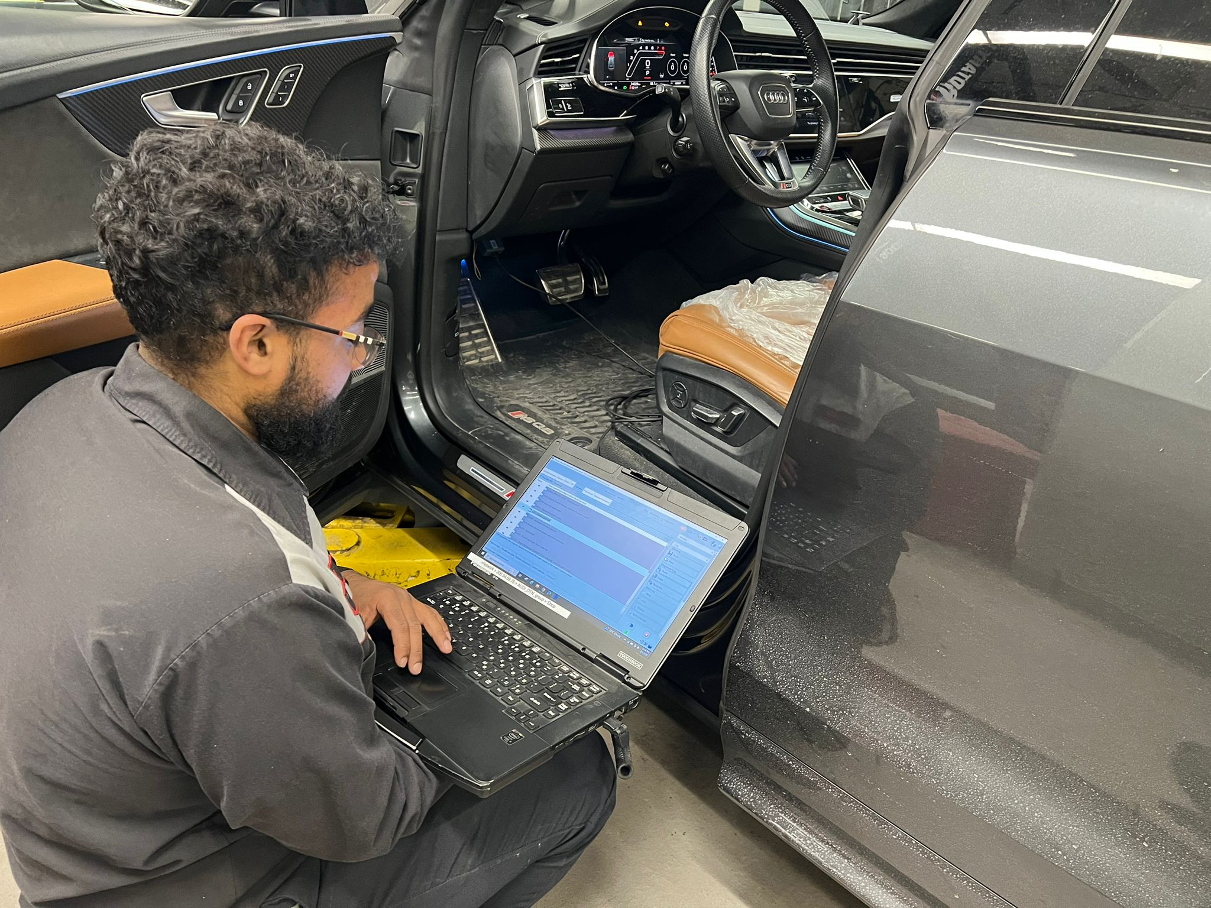
The future of auto repair
is already here.
AutoVivo brings professional auto repair directly to drivers — on-demand, transparent, and stress-free.
✓ Mobile market 8.8% CAGR
✓ 3–5 Mechanics at launch
✓ Full product built & tested
Thank you.
Questions? Let's talk.
autovivo.ca

